Slide 1
System Fundamentals

Slide 2

Types of Network Topology
The arrangement of a network that comprises nodes and connecting lines via sender and receiver is referred to as Network Topology. The various network topologies are:
Point to Point Topology
Bus Topology
Ring Topology
Mesh Topology
Star Topology
Hybrid Topology

Slide 3
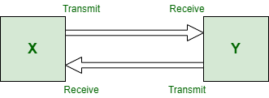
Point to Point Topology
Point-to-Point Topology is a type of topology that works on the functionality of the sender and receiver. It is the simplest communication between two nodes, in which one is the sender and the other one is the receiver. Point-to-Point provides high bandwidth.

Slide 4
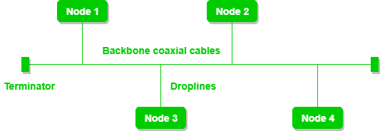
Bus Topology
Bus Topology is a network type in which every computer and network device is connected to a single cable. It is bi-directional. It is a multi-point connection and a non-robust topology because if the backbone fails the topology crashes. In Bus Topology, various MAC (Media Access Control) protocols are followed by LAN ethernet connections.

Slide 5
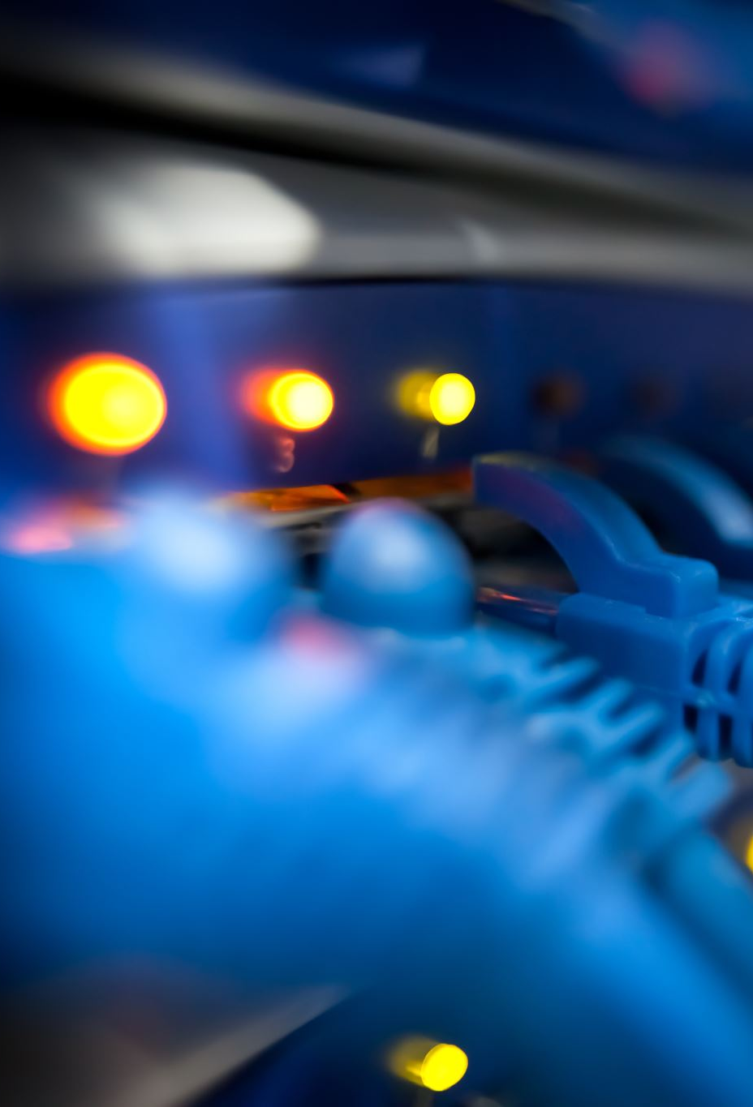
Adventages
If N devices are connected to each other in a bus topology, then the number of cables required to connect them is 1, known as backbone cable.
Coaxial or twisted pair cables are mainly used in bus-based networks that support up to 10 Mbps.
The cost of the cable is less compared to other topologies, but it is used to build small networks.
Bus topology is familiar technology as installation and troubleshooting techniques are well known.

Slide 6

Drawbacks
A bus topology is quite simpler, but still, it requires a lot of cabling.
If the common cable fails, then the whole system will crash down.
If the network traffic is heavy, it increases collisions in the network. To avoid this, various protocols are used in the MAC layer known as Pure Aloha, Slotted Aloha, CSMA/CD, etc.
Adding new devices to the network would slow down networks.
Security is very low.

Slide 7
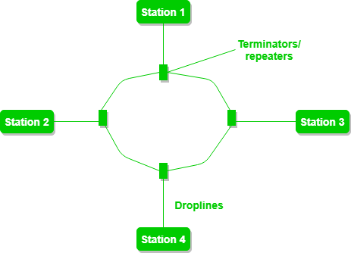
Ring Topology
In a Ring Topology, it forms a ring connecting devices with exactly two neighboring devices. A number of repeaters are used for Ring topology with a large number of nodes, because if someone wants to send some data to the last node in the ring topology with 100 nodes, then the data will have to pass through 99 nodes to reach the 100th node. Hence to prevent data loss repeaters are used in the network.

Slide 8

The most common access method of ring topology is token passing.
Token passing: It is a network access method in which a token is passed from one node to another node.
Token: It is a frame that circulates around the network.

Slide 9
Operation of Ring Topology
One station is known as a monitor station which takes all the responsibility for performing the operations.
To transmit the data, the station has to hold the token. After the transmission is done, the token is to be released for other stations to use.
When no station is transmitting the data, then the token will circulate in the ring.
There are two types of token release techniques: Early token release releases the token just after transmitting the data and Delayed token release releases the token after the acknowledgment is received from the receiver.

Slide 10
Advantages of Ring Topology
The data transmission is high-speed.
The possibility of collision is minimum in this type of topology.
Cheap to install and expand.
It is less costly than a star topology.

Slide 11
Drawbacks
The failure of a single node in the network can cause the entire network to fail.
Troubleshooting is difficult in this topology.
The addition of stations in between or the removal of stations can disturb the whole topology.
Less secure.

Slide 12
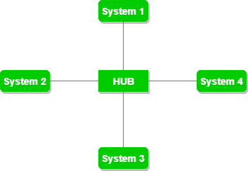
Star
In Star Topology, all the devices are connected to a single hub through a cable. This hub is the central node and all other nodes are connected to the central node. The hub can be passive in nature i.e., not an intelligent hub such as broadcasting devices, at the same time the hub can be intelligent known as an active hub. Active hubs have repeaters in them. Coaxial cables or RJ-45 cables are used to connect the computers. In Star Topology, many popular Ethernet LAN protocols are used as CD(Collision Detection), CSMA (Carrier Sense Multiple Access), etc.

Slide 13
Adventages
If N devices are connected to each other in a star topology, then the number of cables required to connect them is N. So, it is easy to set up.
Each device requires only 1 port i.e. to connect to the hub, therefore the total number of ports required is N.
It is Robust. If one link fails only that link will affect and not other than that.
Easy to fault identification and fault isolation.
Star topology is cost-effective as it uses inexpensive coaxial cable.

Slide 14
Disadventages
If the concentrator (hub) on which the whole topology relies fails, the whole system will crash down.
The cost of installation is high.
Performance is based on the single concentrator i.e. hub.
A common example of star topology is a local area network (LAN) in an office where all computers are connected to a central hub. This topology is also used in wireless networks where all devices are connected to a wireless access point.

Slide 15
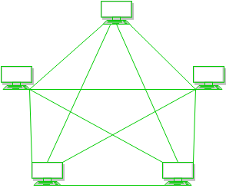
Mesh
In a mesh topology, every device is connected to another device via a particular channel. In Mesh Topology, the protocols used are AHCP (Ad Hoc Configuration Protocols), DHCP (Dynamic Host Configuration Protocol), etc.
Every device is connected to another via dedicated channels. These channels are known as links.

Slide 16
Suppose, the N number of devices are connected with each other in a mesh topology, the total number of ports that are required by each device is N-1. In Figure 1, there are 5 devices connected to each other, hence the total number of ports required by each device is 4. The total number of ports required = N * (N-1).
Suppose, N number of devices are connected with each other in a mesh topology, then the total number of dedicated links required to connect them is ^{N}C₂ i.e. N(N-1)/2. In Figure 1, there are 5 devices connected to each other, hence the total number of links required is 5*4/2 = 10.

Slide 17
Adventages
Communication is very fast between the nodes.
Mesh Topology is robust.
The fault is diagnosed easily. Data is reliable because data is transferred among the devices through dedicated channels or links.
Provides security and privacy.

Slide 18
Drawbacks
Installation and configuration are difficult.
The cost of cables is high as bulk wiring is required, hence suitable for less number of devices.
The cost of maintenance is high.
A common example of mesh topology is the internet backbone, where various internet service providers are connected to each other via dedicated channels. This topology is also used in military communication systems and aircraft navigation systems.

Slide 19

OSI Model
The Open Systems Interconnection (OSI) model describes seven layers that computer systems use to communicate over a network. It was the first standard model for network communications, adopted by all major computer and telecommunication companies in the early 1980s
The modern Internet is not based on OSI, but on the simpler TCP/IP model. However, the OSI 7-layer model is still widely used, as it helps visualize and communicate how networks operate, and helps isolate and troubleshoot networking problems.

Slide 20
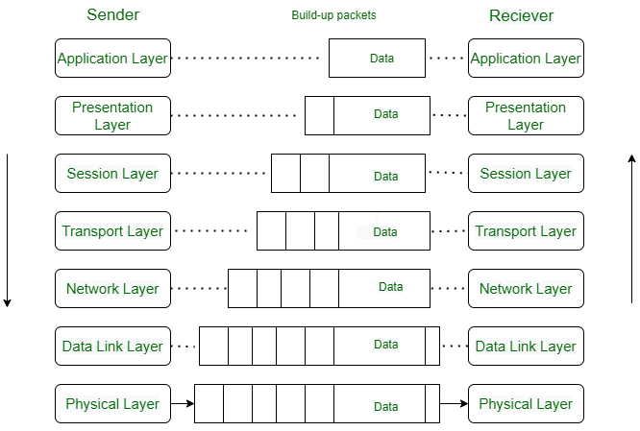
OSI Model - Open Systems Interconnection

Slide 21
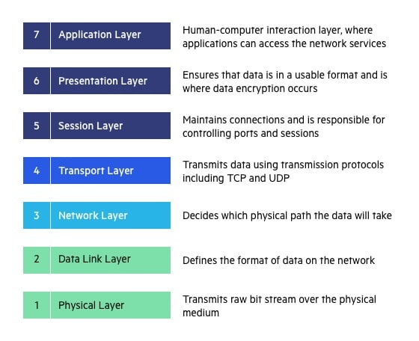

Slide 22
7. Application Layer
The application layer is used by end-user software such as web browsers and email clients. It provides protocols that allow software to send and receive information and present meaningful data to users. A few examples of application layer protocols are the Hypertext Transfer Protocol (HTTP), File Transfer Protocol (FTP), Post Office Protocol (POP), Simple Mail Transfer Protocol (SMTP), and Domain Name System (DNS).
6. Presentation Layer
The presentation layer prepares data for the application layer. It defines how two devices should encode, encrypt, and compress data so it is received correctly on the other end. The presentation layer takes any data transmitted by the application layer and prepares it for transmission over the session layer.

Slide 23
5. Session Layer
The session layer creates communication channels, called sessions, between devices. It is responsible for opening sessions, ensuring they remain open and functional while data is being transferred, and closing them when communication ends. The session layer can also set checkpoints during a data transfer—if the session is interrupted, devices can resume data transfer from the last checkpoint.
4. Transport Layer
The transport layer takes data transferred in the session layer and breaks it into “segments” on the transmitting end. It is responsible for reassembling the segments on the receiving end, turning it back into data that can be used by the session layer. The transport layer carries out flow control, sending data at a rate that matches the connection speed of the receiving device, and error control, checking if data was received incorrectly and if not, requesting it again.

Slide 24
3. Network Layer
The network layer has two main functions. One is breaking up segments into network packets, and reassembling the packets on the receiving end. The other is routing packets by discovering the best path across a physical network. The network layer uses network addresses (typically Internet Protocol addresses) to route packets to a destination node.
2. Data Link Layer
The data link layer establishes and terminates a connection between two physically-connected nodes on a network. It breaks up packets into frames and sends them from source to destination. This layer is composed of two parts—Logical Link Control (LLC), which identifies network protocols, performs error checking and synchronizes frames, and Media Access Control (MAC) which uses MAC addresses to connect devices and define permissions to transmit and receive data.

Slide 25
1. Physical Layer
The physical layer is responsible for the physical cable or wireless connection between network nodes. It defines the connector, the electrical cable or wireless technology connecting the devices, and is responsible for transmission of the raw data, which is simply a series of 0s and 1s, while taking care of bit rate control.

Slide 26
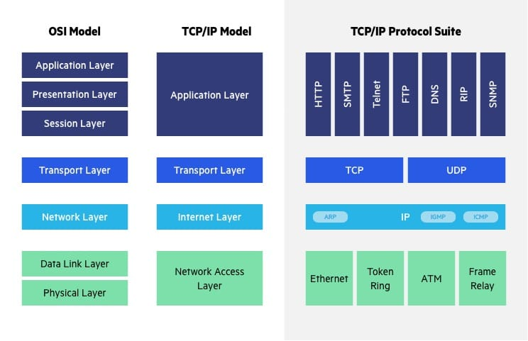

Slide 27
The Transfer Control Protocol/Internet Protocol (TCP/IP) is older than the OSI model and was created by the US Department of Defense (DoD). A key difference between the models is that TCP/IP is simpler, collapsing several OSI layers into one:
OSI layers 5, 6, 7 are combined into one Application Layer in TCP/IP
OSI layers 1, 2 are combined into one Network Access Layer in TCP/IP – however TCP/IP does not take responsibility for sequencing and acknowledgement functions, leaving these to the underlying transport layer.

Slide 28
Other important differences:
TCP/IP is a functional model designed to solve specific communication problems, and which is based on specific, standard protocols. OSI is a generic, protocol-independent model intended to describe all forms of network communication.
In TCP/IP, most applications use all the layers, while in OSI simple applications do not use all seven layers. Only layers 1, 2 and 3 are mandatory to enable any data communication.

Slide 29
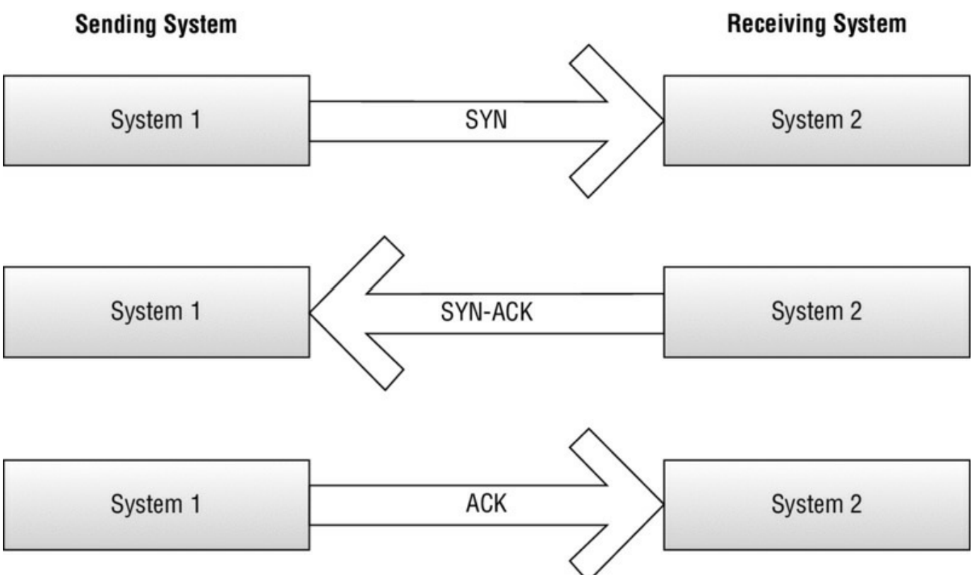
TCP Three Way Handshake

Slide 30

TCP is known as a connection-oriented protocol because it establishes a connection and verifies that packets sent across that connection make it to their destination. The process starts with a SYN packet. This SYN packet starts the handshake process by telling the receiving system that another system wants its attention (via TCP of course). The receiving system then replies to the originating system with a SYN-ACK response. A SYN-ACK response is an acknowledgment response to the original SYN packet. Once the original sender receives the SYN-ACK response, it in turn responds with an ACK packet to verify that it has received the SYN-ACK and is ready to communicate via TCP.

Slide 31
Exploring TCP IP Ports
Ports allow computers to send data out the door while simultaneously identifying that data by category. What this means is each of the common ports you use is associated with a particular protocol or particular application.
Well-known ports are most common in daily operations and range from 1 to 1023.
Registered ports range from 1024 to 49151. Registered ports are those that have been identified as usable by other applications running outside the user’s present purview. An example would be port 1512, which supports Windows Internet Name Service (WINS) traffic. Take a look at Table 2.3 for a list of registered ports of interest.
Dynamic ports range from 49152 to 65535. These are the free ports that are available for any TCP or UDP request made by an application. They are available to support application traffic that has not been officially registered in the previous range.

Slide 32
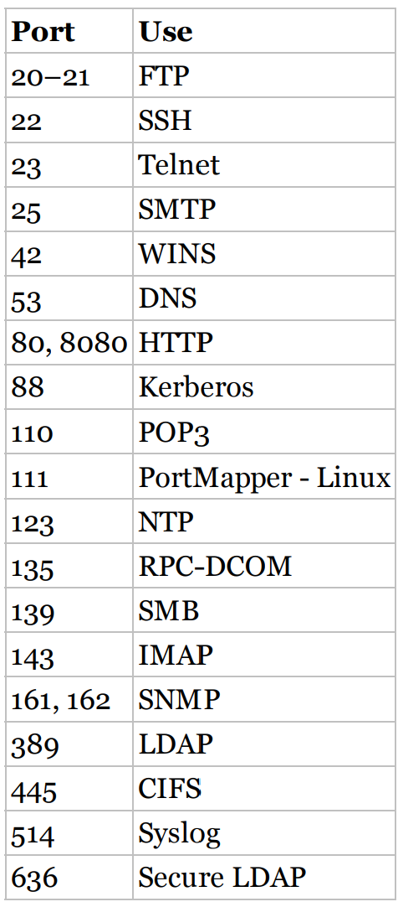
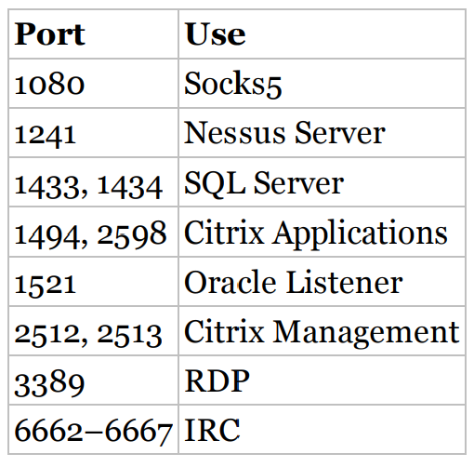
Well-known ports
Registered ports of interest

Slide 33

DNS (Domain Name System)
The Domain Name System (DNS) is the phonebook of the Internet. Humans access information online through domain names, like facebook.com or gmail.com. Web browsers interact through Internet Protocol (IP) addresses. DNS translates domain names to IP addresses so browsers can load Internet resources.
Each device connected to the Internet has a unique IP address which other machines use to find the device. DNS servers eliminate the need for humans to memorize IP addresses such as 192.168.1.1 (in IPv4), or more complex newer alphanumeric IP addresses such as 2400:cb00:2048:1::c629:d7a2 (in IPv6).

Slide 34
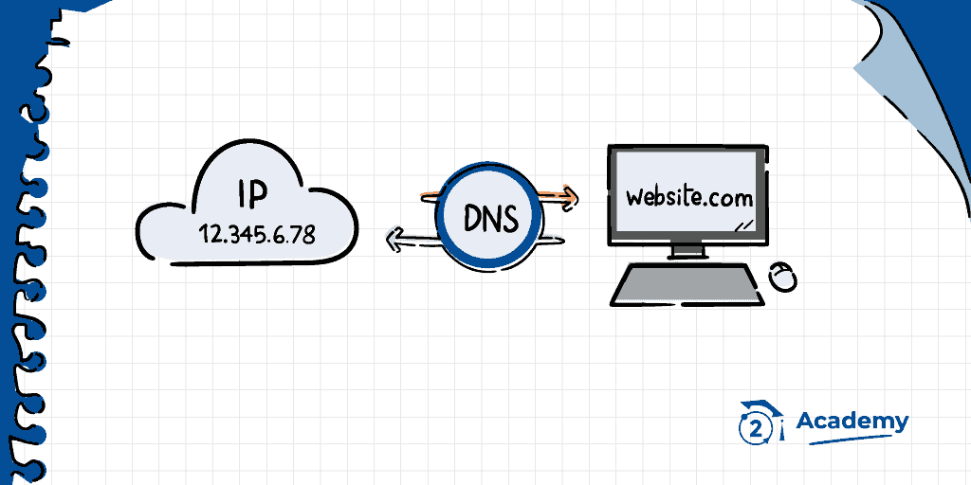

Slide 35
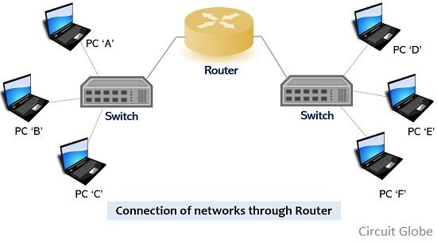
Understanding Network Devices
Router & Switch
Both Routers and Switches are network connecting devices. Routers work at the network layer and are responsible to find the shortest path for a packet across the network, whereas Switches connect various devices in a network. Routers connect devices across multiple networks.

Slide 36

Proxies & Firewall
No network device discussion would be complete without delving into the world of proxies and firewalls. These devices are the bread and butter of ethical hackers in that they are the devices deliberately put in place to prevent unauthorized access. To test the strength of an organization’s perimeter is to ensure that its perimeter gate guard is alive and well.

Slide 37
Proxy Server
Proxy server refers to a server that acts as an intermediary between the request made by clients, and a particular server for some services or requests for some resources. There are different types of proxy servers available that are put into use according to the purpose of a request made by the clients to the servers. The basic purpose of Proxy servers is to protect the direct connection of Internet clients and internet resources. The proxy server also prevents the identification of the client’s IP address when the client makes any request is made to any other servers.

Slide 38
Internet Client and Internet resources: For internet clients, Proxy servers also act as a shield for an internal network against the request coming from a client to access the data stored on the server. It makes the original IP address of the node remains hidden while accessing data from that server.
Protects true host identity: In this method, outgoing traffic appears to come from the proxy server rather than internet navigation. It must be configured to the specific application such as HTTPs or FTP. For example, organizations can use a proxy to observe the traffic of its employees to get the work efficiently done. It can also be used to keep a check on any kind of highly confidential data leakage. Some can also use it to increase their websites rank

Slide 39
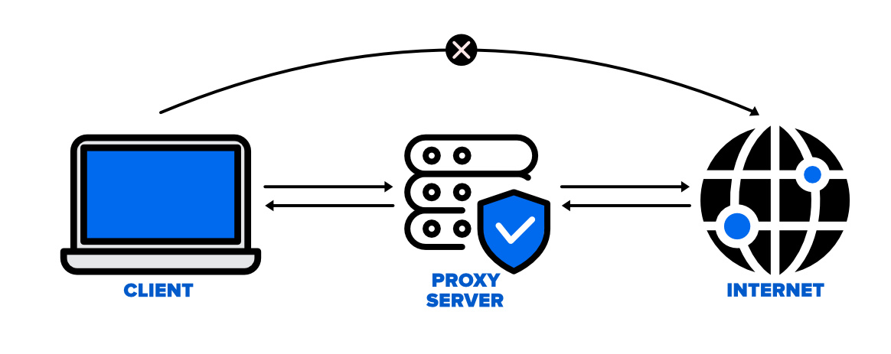

Slide 40
Firewall
A firewall is a network security device that monitors incoming and outgoing network traffic and decides whether to allow or block specific traffic based on a defined set of security rules.
Firewalls have been a first line of defense in network security for over 25 years. They establish a barrier between secured and controlled internal networks that can be trusted and untrusted outside networks, such as the Internet.
A firewall can be hardware, software, software-as-a service (SaaS), public cloud, or private cloud (virtual).

Slide 41
Commonly broken down into the following main categories:
Packet filtering
Stateful packet filtering
Application proxies

Slide 42
Packet-filtering firewalls look at the header information of the packets to determine legitimate traffic. Rules such as IP addresses and ports are used from the header to determine whether to allow or deny the packet entry.
Stateful firewalls, on the other hand, determine the legitimacy of traffic based on the state of the connection from which the traffic originated. For example, if a legitimate connection has been established between a client machine and a web server, then the stateful firewall refers to its state table to verify that traffic originating from within that connection is legitimate.
An application proxy is one of the most secure firewall types that can be deployed. The proxy sits between the protected network and the rest of the world. Every packet sent outbound is intercepted by the proxy, which initiates its own request and processes the response

Slide 43
Intrusion Detection System
An Intrusion Detection System (IDS) is a monitoring system that detects suspicious activities and generates alerts when they are detected. Based upon these alerts, a security operations center (SOC) analyst or incident responder can investigate the issue and take the appropriate actions to remediate the threat.

Slide 44
Classification of IDS
Host-Based IDS (HIDS): A host-based IDS is deployed on a particular endpoint and designed to protect it against internal and external threats. Such an IDS may have the ability to monitor network traffic to and from the machine, observe running processes, and inspect the system’s logs. A host-based IDS’s visibility is limited to its host machine, decreasing the available context for decision-making, but has deep visibility into the host computer’s internals.
Network-Based IDS (NIDS): A network-based IDS solution is designed to monitor an entire protected network. It has visibility into all traffic flowing through the network and makes determinations based upon packet metadata and contents. This wider viewpoint provides more context and the ability to detect widespread threats; however, these systems lack visibility into the internals of the endpoints that they protect.

Slide 45
Intrusion Prevention System (IPS)
An intrusion prevention system (IPS) is a network security tool (which can be a hardware device or software) that continuously monitors a network for malicious activity and takes action to prevent it, including reporting, blocking, or dropping it, when it does occur.
It is more advanced than an intrusion detection system (IDS), which simply detects malicious activity but cannot take action against it beyond alerting an administrator

Slide 46
How does an intrusion prevention system work?
An intrusion prevention system is placed inline, in the flow of network traffic between the source and destination, and usually sits just behind the firewall. There are several techniques that intrusion prevention systems use to identify threats:
Signature-based: This method matches the activity to signatures of well-known threats. One drawback to this method is that it can only stop previously identified attacks and won’t be able to recognize new ones.
Anomaly-based: This method monitors for abnormal behavior by comparing random samples of network activity against a baseline standard. It is more robust than signature-based monitoring, but it can sometimes produce false positives. Some newer and more advanced intrusion prevention systems use artificial intelligence and machine learning technology to support anomaly-based monitoring.
Policy-based: This method is somewhat less common than signature-based or anomaly-based monitoring. It employs security policies defined by the enterprise and blocks activity that violates those policies. This requires an administrator to set up and configure security policies.
Once the IPS detects malicious activity, it can take many automated actions, including alerting administrators, dropping the packets, blocking traffic from the source address, or resetting the connection. Some intrusion prevention systems also use a “honeypot,” or decoy high-value data, to attract attackers and stop them from reaching their targets.

Slide 47
Classification of IPS
Network intrusion prevention system (NIPS): This type of IPS is installed only at strategic points to monitor all network traffic and proactively scan for threats.
Host intrusion prevention system (HIPS): In contrast to a NIPS, a HIPS is installed on an endpoint (such as a PC) and looks at inbound and outbound traffic from that machine only. It works best in combination with a NIPS, as it serves as a last line of defense for threats that have made it past the NIPS.
Network behavior analysis (NBA): This analyzes network traffic to detect unusual traffic flows, such as DDoS (Distributed Denial of Service) attacks.
Wireless intrusion prevention system (WIPS): This type of IPS simply scans a Wi-Fi network for unauthorized access and kicks unauthorized devices off the network.

Slide 48

Knowing OS
Windows: Windows is an operating system developed by Microsoft. It is one of the most widely used operating systems for personal computers (PCs) and is known for its user-friendly interface. Windows supports a vast range of software and hardware, making it popular among various users, including home users, businesses, and enterprises. Over the years, different versions of Windows have been released, with Windows 11 being the last major version.

Slide 49
MacOs
macOS is the operating system developed by Apple Inc. It is designed exclusively for Apple's Mac computers. macOS is known for its sleek and visually appealing user interface, as well as its integration with other Apple devices and services. Apple regularly releases updates to macOS, bringing new features and improvements. macOS is known for its stability and security and is favored by creative professionals and developers due to its seamless integration with software like Final Cut Pro, Logic Pro, and Xcode

Slide 50

Android
Android is an open-source operating system developed by Google. It is primarily designed for mobile devices, including smartphones and tablets. Android has become the most widely used mobile operating system globally. Its open-source nature allows device manufacturers to customize and adapt it to their specific hardware configurations. Android offers access to a vast ecosystem of apps through the Google Play Store. It is highly customizable, allowing users to personalize their devices extensively.

Slide 51
Linux
Linux is an open-source operating system that is based on the Unix operating system. It is available in various distributions (distros) such as Ubuntu, Fedora, Debian, CentOS, and more. Linux is known for its stability, security, and flexibility. It is widely used in servers, supercomputers, embedded devices, and as an alternative to other operating systems on desktops and laptops. Linux is favored by developers and system administrators due to its command-line interface, which provides powerful control over the system.

